Slide 1


Python Fundamentals

Slide 2
AGENDA
Introduction
Python environments
Variables and Data Types
Objects and Data Structures
Operators and Operands
Homework

Slide 3
Introduction
What is Python?
Python is high-level scripting language
Implements the imperative
Object-orientated
Functional paradigms
Open source and communite driven
Source can be compiled or run just-in-time

Slide 4



Introduction
Why Python?
No universal agreement on which scripting language is the best
One of the most flexible, reliable and efficient programming language
Easy to use and learn
Hundreds of Python Libraries and Frameworks
Python applications are universal

Slide 5
Introduction
Versions
Current production versions are 2.x.x and 3.x.x
Both version are stable and suitable for use
Python3: relatively major redisign
Not backward compatible

Slide 6

Introduction
Interesting features
White space has semantics
Statements are terminated by <Enter>
No variable declaration
Dynamic typing
Associative arrays

Slide 7
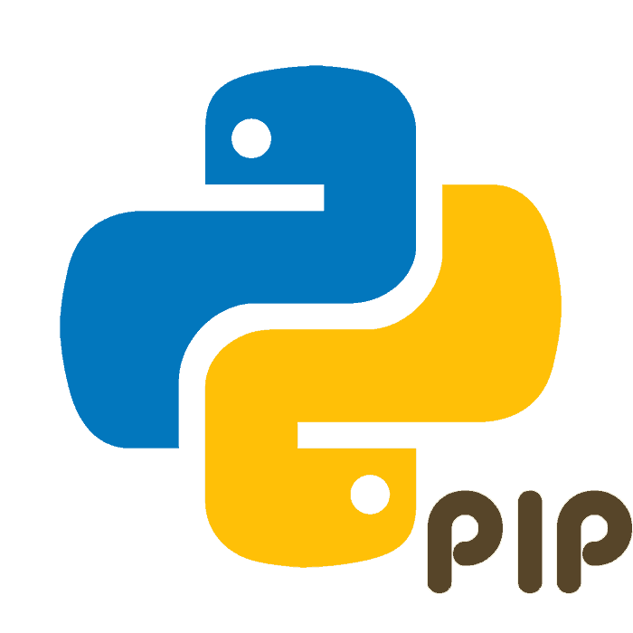
Introduction
PIP & Requirements file
Package manager
Install and manage additional libraries and dependencies
Included in Python installers
requirements.txt
Fine-Tuning Requirements
Freezing Requirements per environment

Slide 8

Python environments
Development environments
IDEs - cross-platform development environments:
PyCharm
Visual Studio Code
Etc.
Python Shell

Slide 9

Python environments
Virtual Environments
Pipenv:
Packaging tool
Simplifies the development process
Virtual environments
Isolated environment for projects
Docker

Slide 10

Variables & Data Types
Python Elements
Keywords
Reserved words
Identifiers
Names given to entities
Writing rules
Statements
Single line statement
Multiline statement

Slide 11


Variables & Data Types
Explicit line continuation
Implicit line continuation

Slide 12
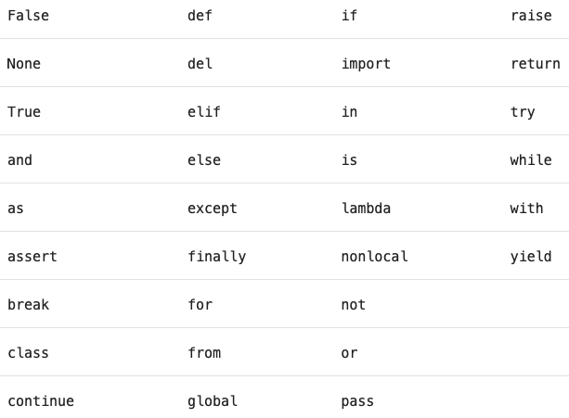
Variables & Data Types
Keywords

Slide 13
Variables & Data Types
Variables
Automatically declared
Variables contains references to data values
Created when value is assigned
Don’t use a variable name in a statement until has been assgined a value
No static types

Slide 14
Variables & Data Types
Data Types
Numeric Types:
Integer
Sequence of decimal digits without any prefix to be a decimal number
Binary, octal and hexadecimal values
Floats
Values specified with a decimal point
Complex
Specified as <real part>+<imaginary part>j
Boolean
True or False
Strings
Sequences of character data

Slide 15
Variables & Data Types
Type Convertion Functions
Implicit Type Conversion
Interpreter automatically converts one data type to another
Explicit Type Conversion
Data type is manually changed by the user as per their requirement

Slide 16
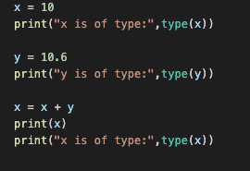
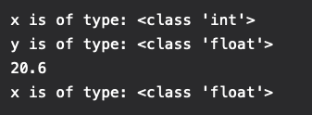
Variables & Data Types
Implicit Type Conversion

Slide 17
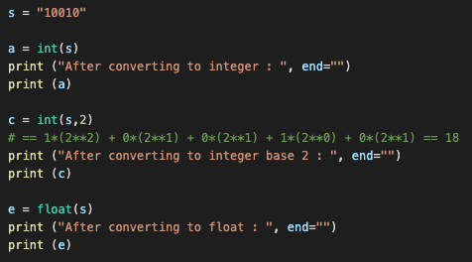

Variables & Data Types
Explicit Type Conversion

Slide 18
Objects & Data Structures
Objects
Object-oriented programming (OOP) concept
Objects bundle properties and behaviors
>>> print(300)

Slide 19
Objects & Data Structures
Variable is a named location used to store data in memory
>>> n = 7
>>> m = n
n
7
n
7
m

Slide 20
Objects & Data Structures
Data Structures
Array Data Structures:
List
Tuple
Dictionaries, Maps and Hash Tables:
Dict
Sets

Slide 21
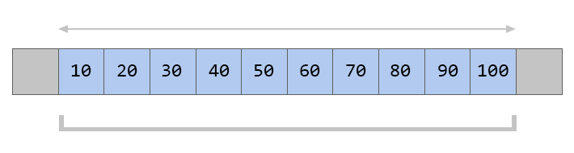
Objects & Data Structures
Array Data Strucutres
Fixed-size data record that allow each element to be efficiently located based on its index
Contiguous data structures
0 1 2 3 4 5 6 7 8 9

Slide 22
Objects & Data Structures
[ ]
Lists
Comma-separated sequence of items, enclosed in square brackets
>>> myList = ["one", "two", "three"]
Can contain heterogeneous data
>>> myList = ["one", "two", ”3"]
Mutable
>>> myList = "hello”
['one', 'hello’, 3]
Can be sliced, indexed, concatenated and repeated

Slide 23
Objects & Data Structures
( )
Tuples
Like a list, tuples are iterable arrays of objects
Immutable - unchangable
Item separated by commas are enclosed within brackets ()
Example uses of tuples:
Country Names
Ordered set of functions
Land Use Codes
t = (1, 2, ‘Python’, (14, ‘Viktor’) )
t[0] t[1] t[3] t[4]

Slide 24
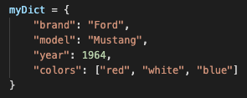
Objects & Data Structures
{ }
Dictionaries
Ordered collection of elements
Mutable
Indexed by keys
Consist of <key, value> pairs
Keys are the unique identifiers
Dict is defined within curly brackets {}

Slide 25
Objects & Data Structures
{ }
Sets
Unordered collection of objects
Doesn’t allow duplicate elements
Mutable
Backed by the dict data type and share the same performance characteristics
Use cases:
Test a value for membership in a set
Insert or delete new values from a set
Compute the union or intersection of two sets

Slide 26
Operators & Operands
Operators are special symbols that carry out arithmetic or logical coputation
The value that operator operates on is called the operand
Example:
>>> 2 + 3
5
+ is operator that performs addition
2 and 3 are the operands and 5 is the output of the operation

Slide 27
Operators & Operands
Arithmetic Operators
Used to perform mathematical operations
Addition
x + y
Subtraction
x - y
Multiplication
x * y
Division
x / y
Modulus
x % y
Exponentiation
x ** y
Floor division
x // y

Slide 28
Operators & Operands
Assignment Operators
Used to perform operations on values and variables
Carry out arithmetic, logical, bitwise computations
Assign
x = y + z
Add and Assign
a += b
Subtract AND Assign
a -= b
Multiply AND Assign
a *= b
Divide AND Assign
a /= b
Modulus AND Assign
a %= b
Divide(floor) AND Assign
a //= b
Exponent AND Assign
a **= b

Slide 29
Operators & Operands
Assignment Operators
Performs Bitwise AND and Assign
a &= b
Performs Bitwise OR and Assign
a |= b
Performs Bitwise XOR and Assign
a ^= b
Performs Bitwise right shift and Assign
a >>= b
Performs Bitwise left shift and Assign
a <<= b

Slide 30
Operators & Operands
Comparison Operators
Also called relational operators
Compare the values of two operands and return True or False
Equal
a == b
Not equal
a != b
Greater than
a > b
Less than
a < b
Greater than or equal to
a >= b
Less than or equal to
a <= b

Slide 31
Operators & Operands
Logical Operators
Used for conditional statements
AND operator
returns TRUE if both the operands (right side and left side) are true
OR operator
returns TRUE if either of the operand (right side or left side) is true
NOT operator
returns TRUE if operand is false

Slide 32

Iterators
Looping with For
Definite iteration
Allows to loop over a block of code a set number of times
Used for manipulating data structures

